Slide 1
TEAM MANAGERS’ BRIEFING

Slide 2

SAFETY
Mandatory for all driver before taking part in the 1st event

Slide 3
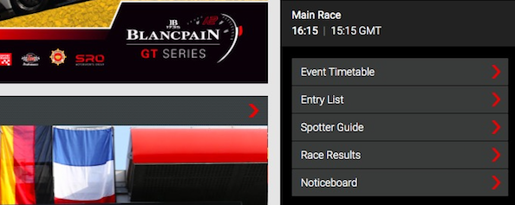
VIRTUAL NOTICE BOARD
http://www.blancpain-gt-series.com
Calendar 2018
Select the Current race
Click on
Bottom of the screen RHS

Slide 4
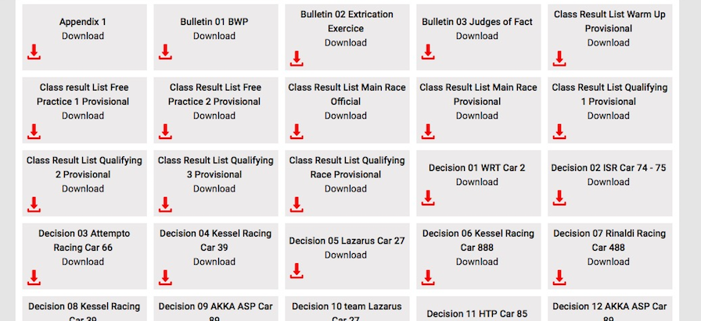
VIRTUAL NOTICE BOARD

Slide 5
OFFICIAL MAILING LIST
FOR DOCUMENT DISTRIBUTION
Change of address or new addresses please contact
Murielle the secretary in charge of communications at
sporting@sro-motorsports.com

Slide 6
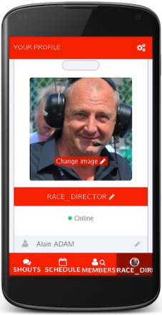
TEAM MESSAGING App
http://blancpain-gt-series.minsh.com/launch.html
  Only everybody messages during the sessions.
  Do not forget to record your car number
Summons
Requests
Incident reports
Decisions…

Slide 7
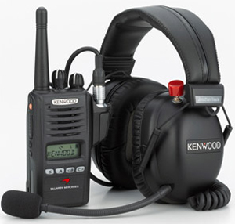
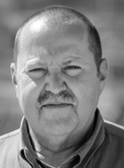
RACE DIRECTOR RADIO
  TEST 10 minutes before
  each session
  Answer ”ok” on the team messaging
  In case of issue contact the Pit Lane manager – Ghislain VERRIEST

Slide 8
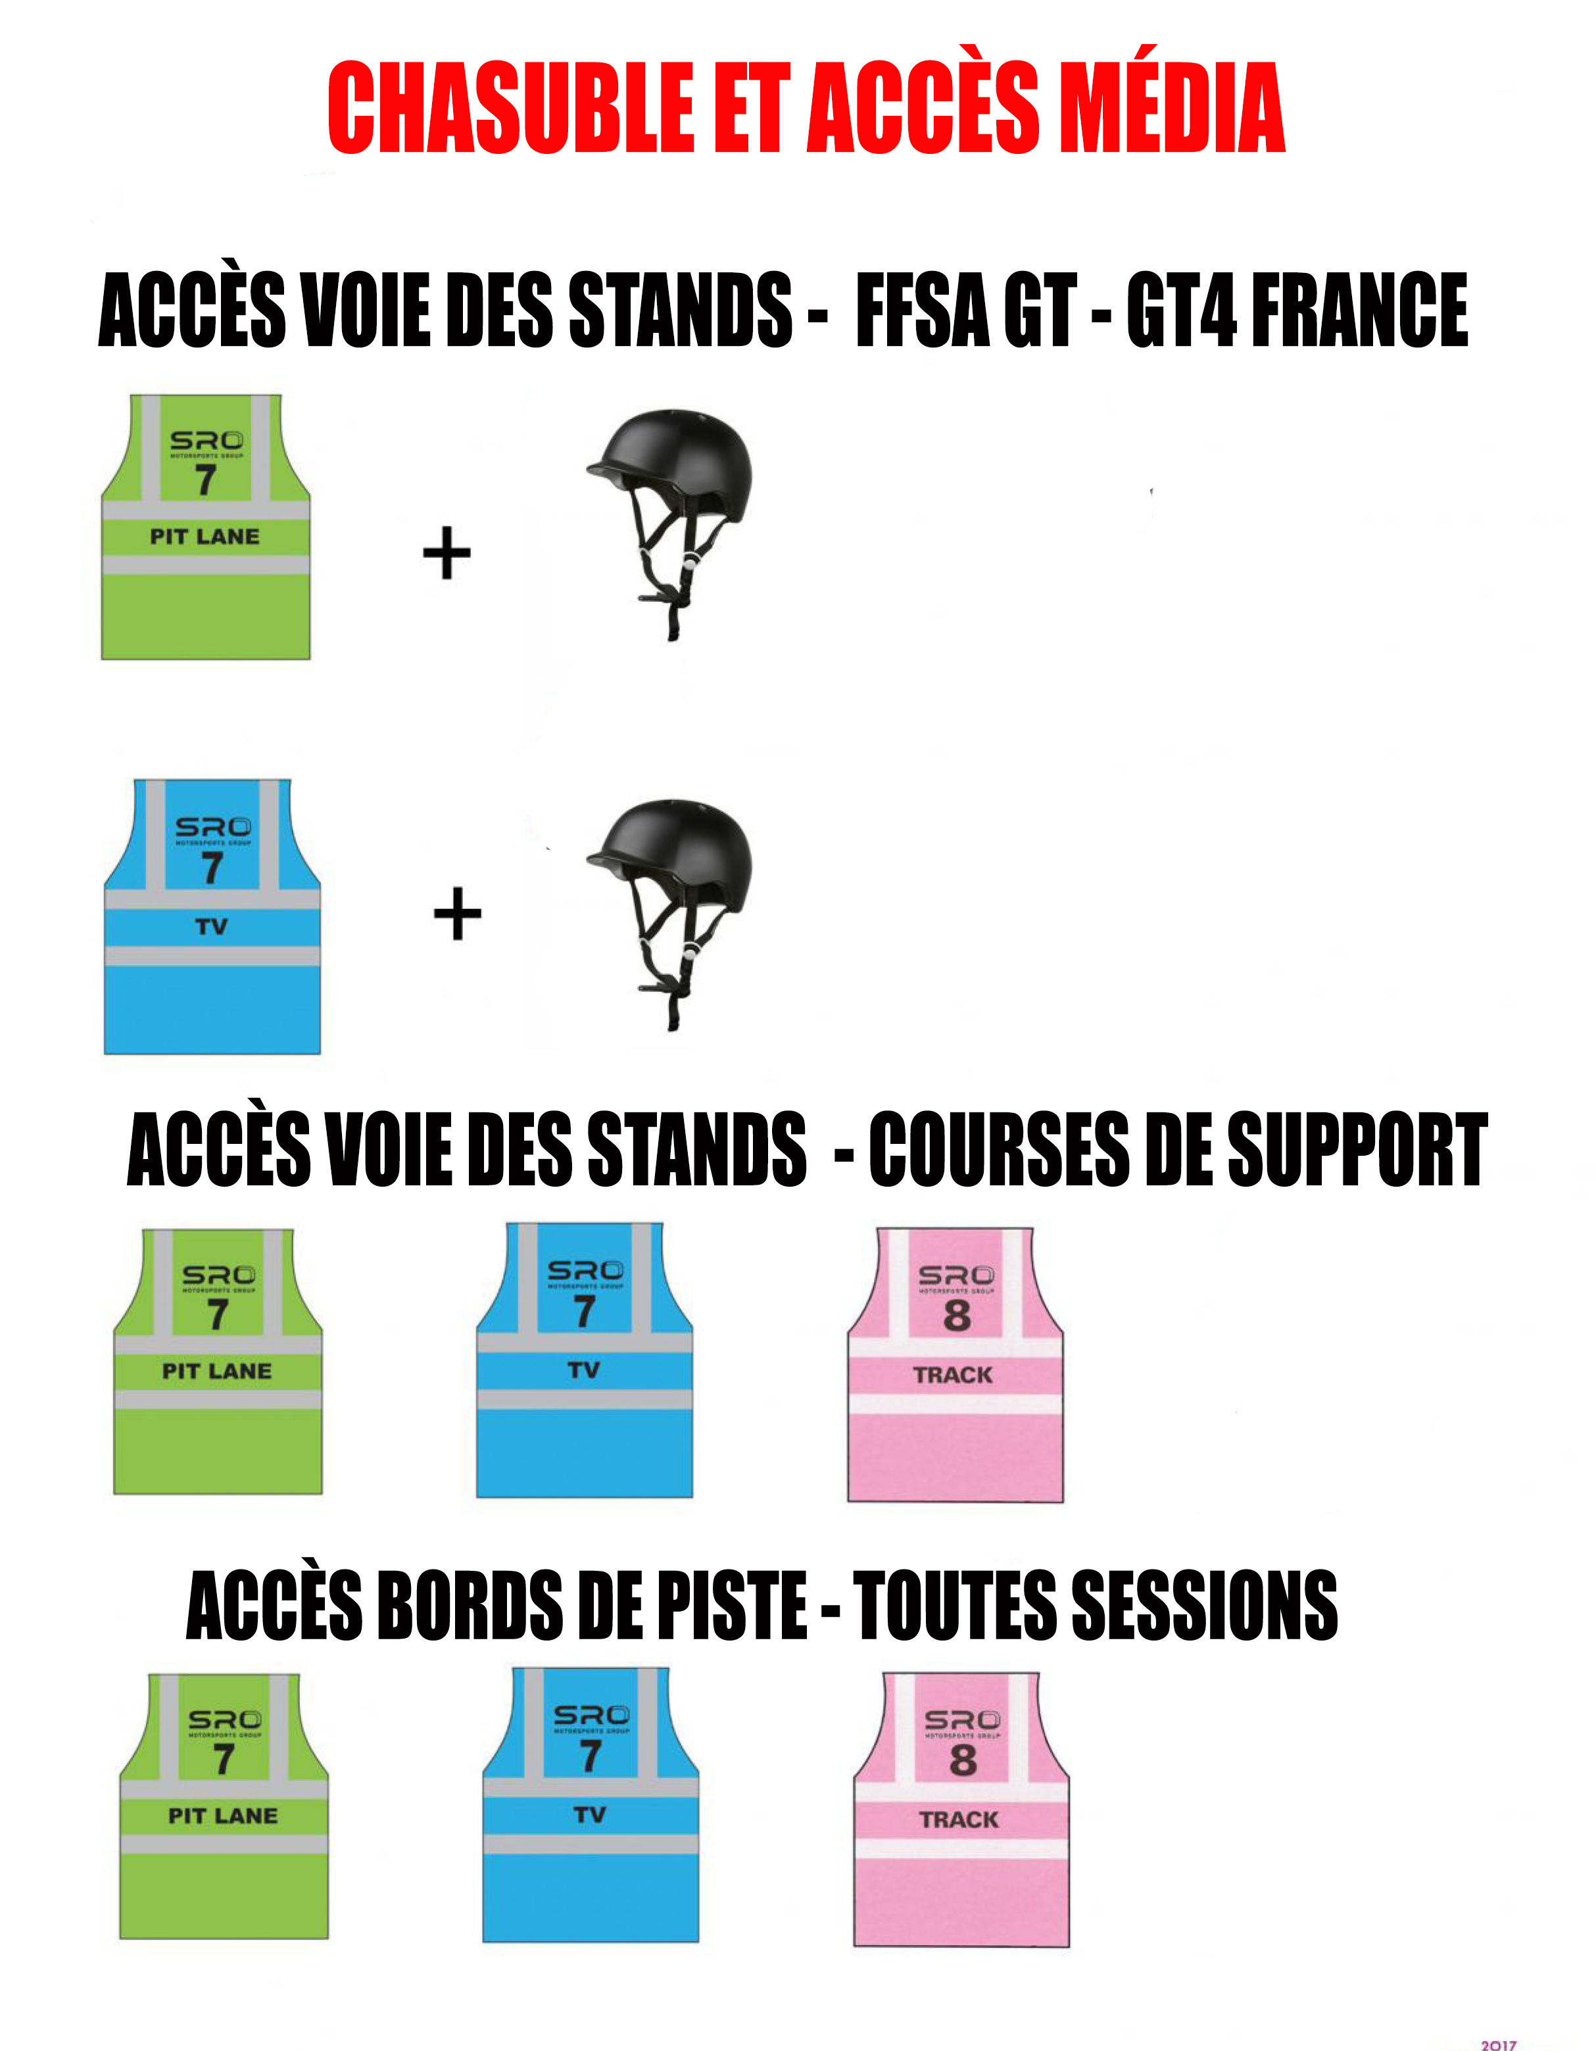
BLANCPAIN GT SPRINT SERIES

Slide 9
Alcohol and doping
Alcohol tolerance is 0
Check 3 hours > session < 30’ after
Be aware of the Anti-doping regulations
Check the FIA web site

Slide 10
Info
  Onboard SAFETY cameras – Checked at scrutineering – SD from SRO
  Additional “On board Camera” –request form Tech delegate
In Am: driver > 85 Kg – average weight reduced from the BOP
Flashing head lights Max 3 times between two corners
Wheels (warm) to the grid - before pit lane closes
Pit gantry cameras mandatory recording during pit stops
5’ before beginning of each session cars at 45°.
Pit stop area allocated – Pit lane manager and RD
Time spent in pit lane (DT, TP, FCY, SC) not in driver stint
Notes:
10

Slide 11
FAST LANE OPEN
  Max 5’ before session.
  FAST LANE OPEN
  On the timing monitors and RD radio
  Cars allowed to Pit Exit
  Not for the race
  Also valid in case of Red flag
Notes:
11

Slide 12
PIT STOP ARMBANDS
Max 1 armband at any time (on the arm)
Mechanics: 4 Red per entered car in Endurance.
Car controller: 1 White – only visual checks.
Industry: 1 Yellow
Flame-resistant clothes
No equipment in working before the car is stopped
Car controller & driver allowed in working lane 1Lap before.
Nobody in front of the car (standing behind the panels-use lollipops!
Skates allowed to move cars in the working lane.
Art 153-158 tyre&driver change may happen during refuelling
Notes:
12

Slide 13
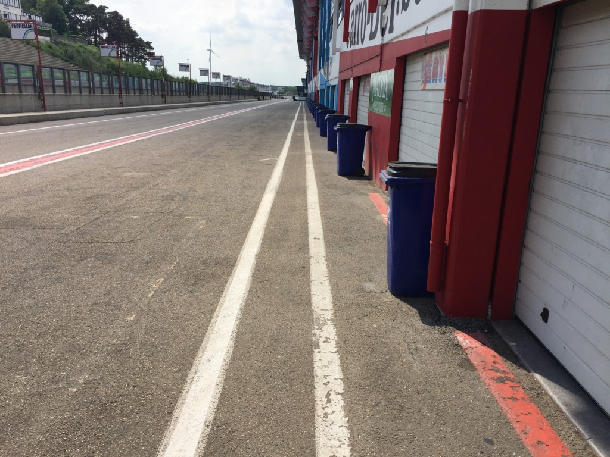
PIT LANE
FAST LANE
WORKING LANE
LIMIT WORKING LANE

Slide 14
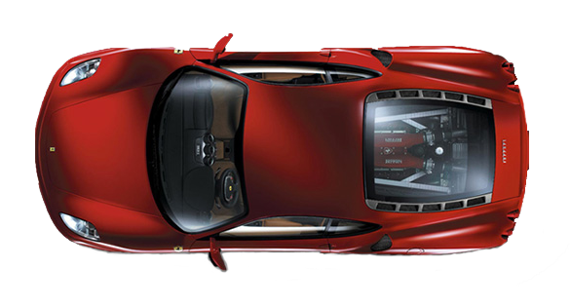
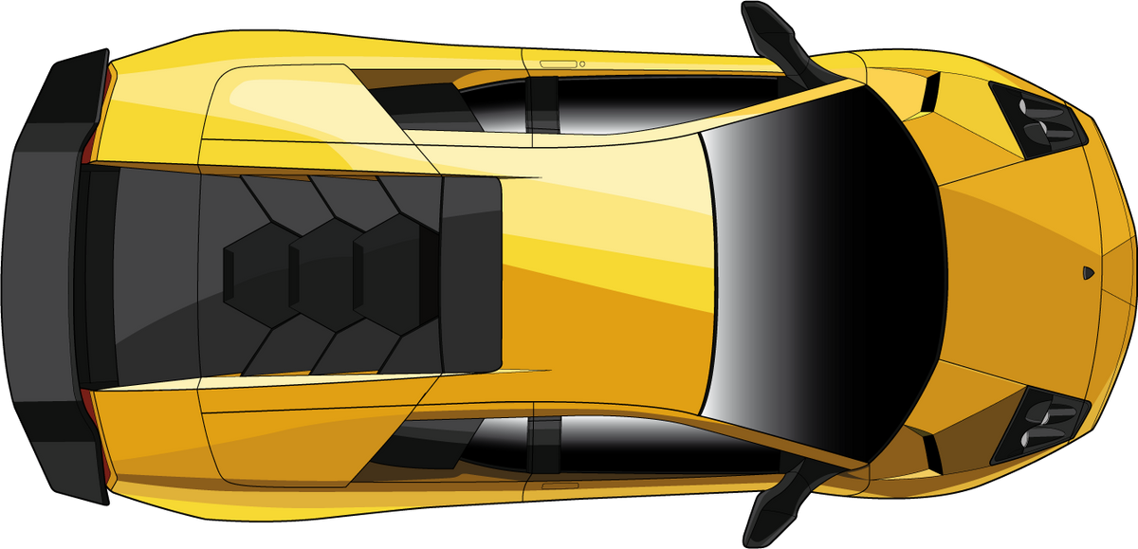

START OF ALL SESSIONS 45°
FAST LANE
WORKING LANE
GARAGES

Slide 15
PIT STOP AND RACE

Slide 16
OTHER WORKS

Slide 17
ALLOCATED AREA

Slide 18
SWISS TIMING DATA FEED

Slide 19

PROCEDURE
Slow down to 80 Km/Hr - NO overtaking
Free practices: - The clock will NOT stop
- enter the pit lane – to your pit
During Qualifying: - The clock stops
- enter the pit lane – to your pit
During the race: - The clock will stop
- Cars to line up in front of the red line
- Order: as when the red flag was declared
- Teams and officials ONLY
– Parc-Fermé conditions – Restart behind SC
If you enter the pits after the red flag: restart one lap later

Slide 20
PROCEDURE
During the pit window:
- Cars back to the pit
– Parc-Fermé conditions
- pit stop permitted, when done PF
- Marshals will call the cars to line up in the order at the line of the last full lap before the opening of the pit window

Slide 21
GENERAL INFORMATION
FP: pit garage - Cars nose IN to enter the garage
Joker tyres form - RD to confirm an incident or issue in which the tyres were damaged.
No cars in the pit lane during Q & R of other Series
This is a NO contact sport
Incidents involving different categories, the more PRO Cat will be deemed to be at fault unless evidence clearly shows the contrary.
Notes:
21

Slide 22
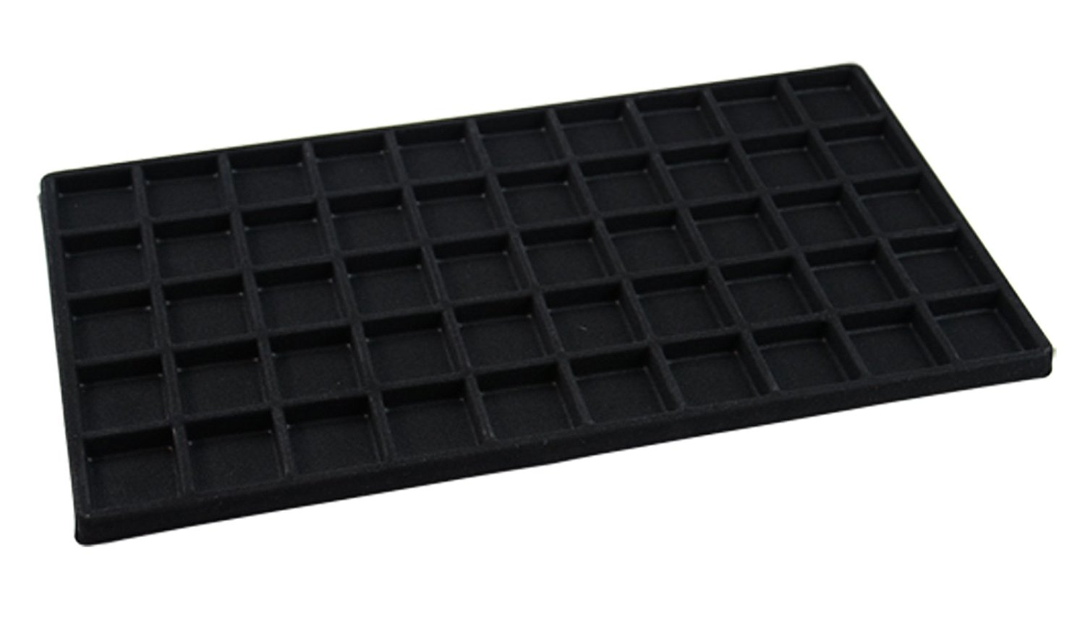
SD CARDS
At the end of each races safety cards will be collected in parc-fermé
But the pit gantry camera must be br ught by the team to 1st floor entrance desk

Slide 23

Notes:
23

Slide 24
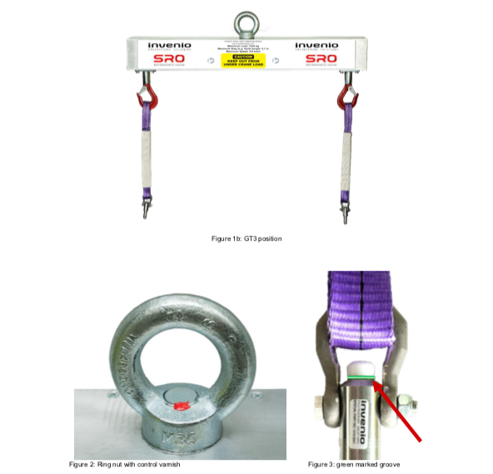

Slide 25
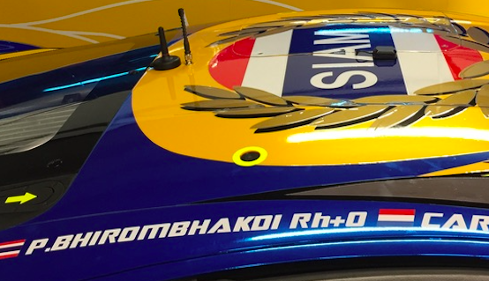
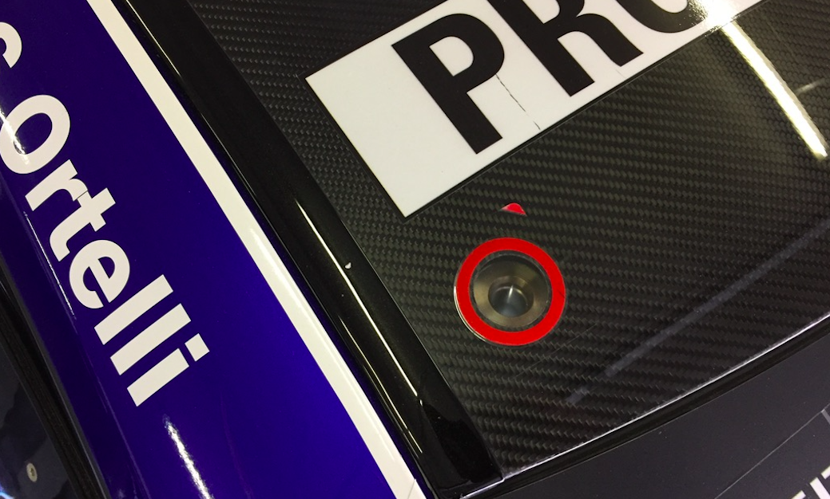
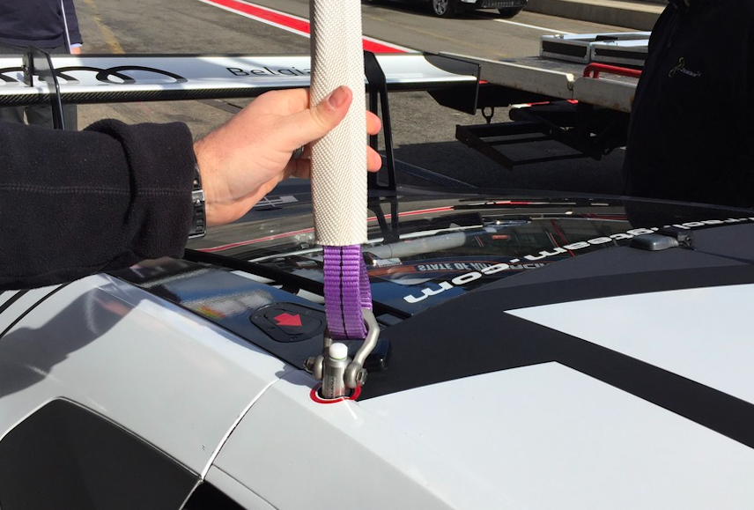
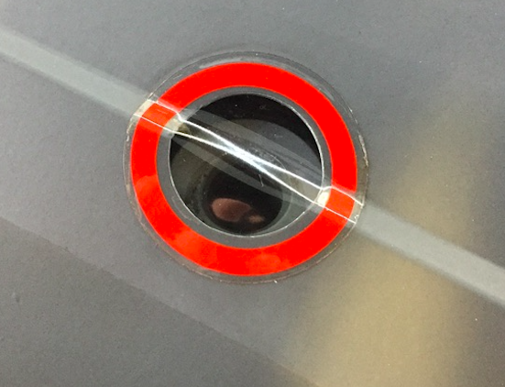
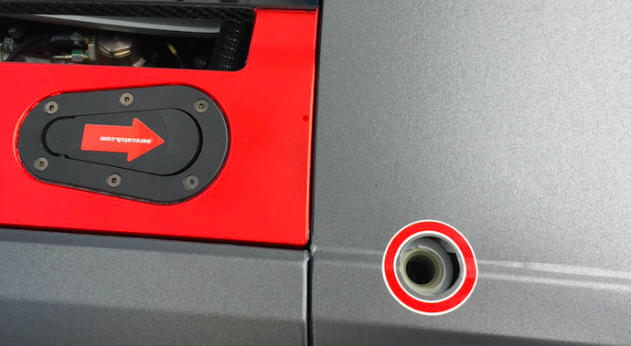

Slide 28
in the race control tower :
RD and sporting director 1st floor n° 4
Stewards 1st floor n° 2
OFFICES

Slide 29
DRIVERS’ BRIEFING

Slide 30
Zolder (BELGIUM)
Circuit length: 4000 m
Start line offset: 0 m
Intermediate 1 at: 1376,4 m
Intermediate 2 at: 2864,6 m
Pit IN to Pit OUT: 411 m
T2
T3
Start
T1
T16
Finish
Medical centre
T14
T4
T12
T15
T6
T5
Int 1
T13
Parc-Fermé
RHS pit exit
T7
Int 2
T9
T8
T11
T10

Slide 31
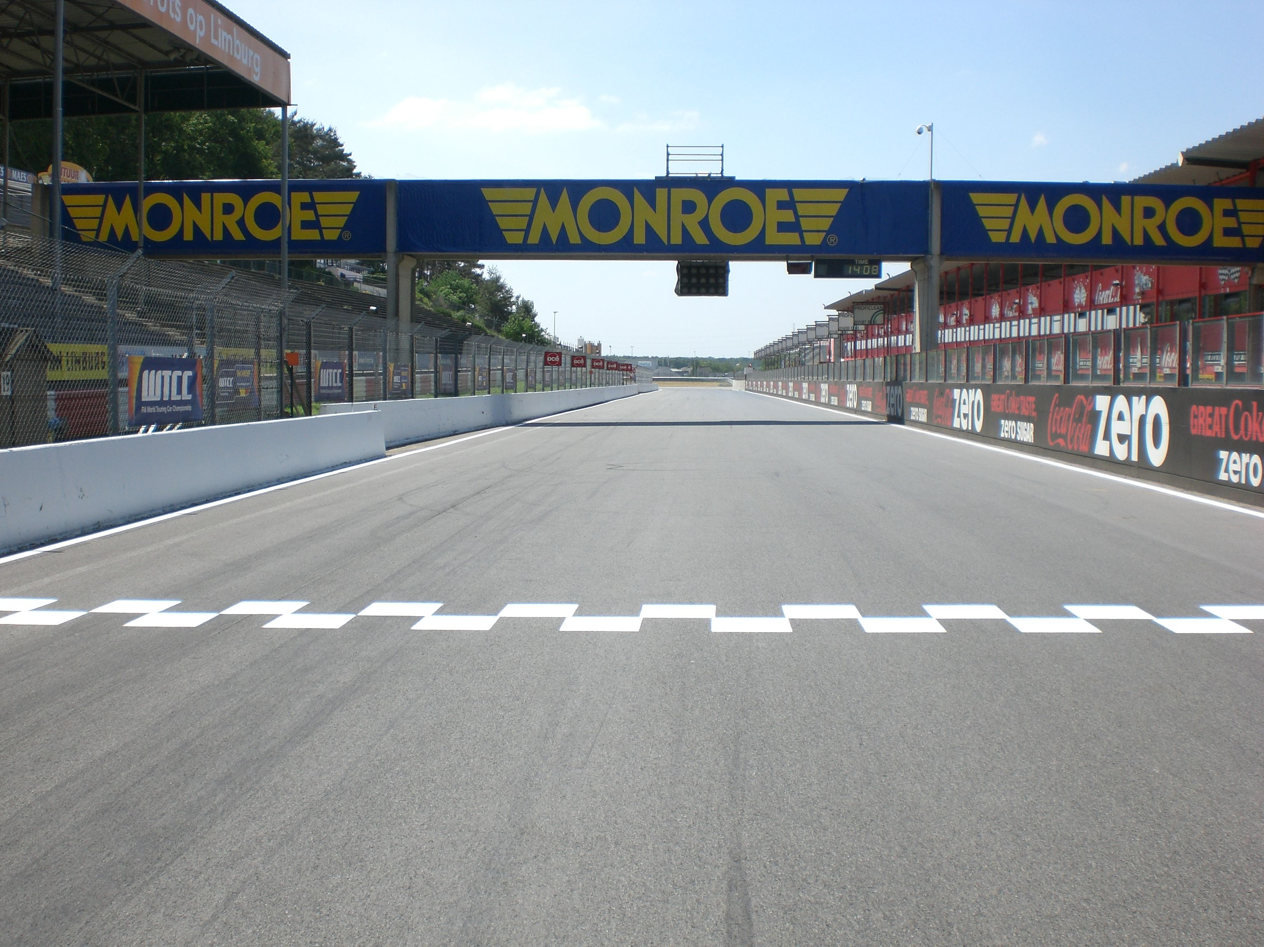

CONTROL, START & FINISH LINES

Slide 32
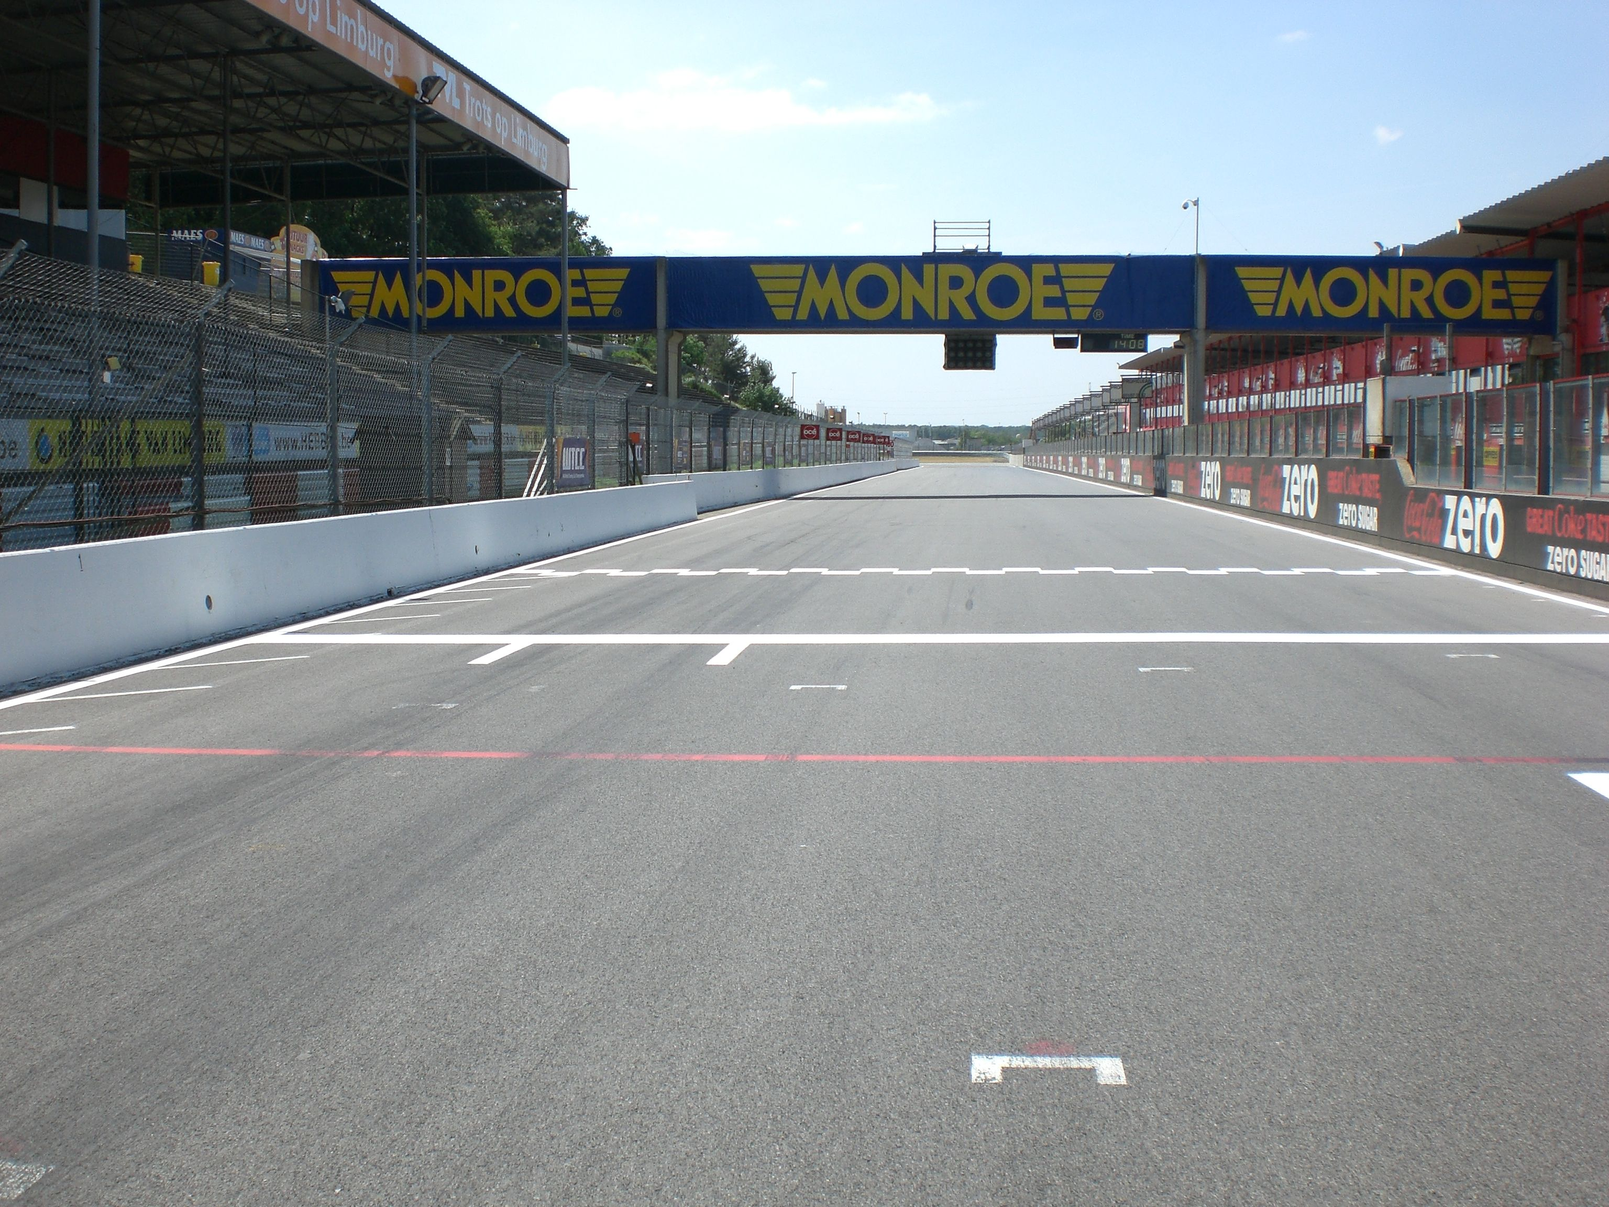
RED LINE

Slide 33
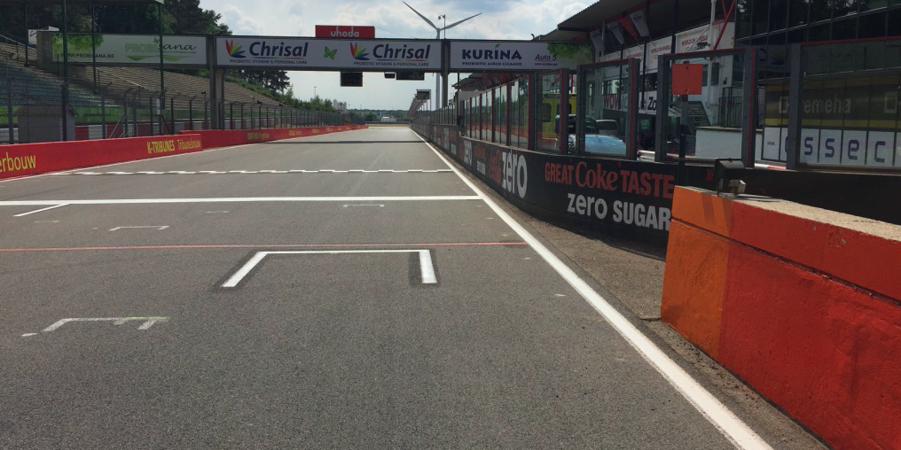




SIGNALING AREA
DRIVE THROUGH

Slide 34

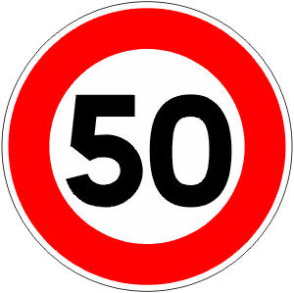
PIT LANE
PIT
ENTRY
Speed limit
ENDS
Speed limit
STARTS
PIT EXIT
LIGHTS
SAFETY CAR LINE 1
START
FINISH
LINE
RED FLAG
LINE
PIT
EXIT
BLUE
FLAG
SAFETY CAR LINE 2

Slide 35
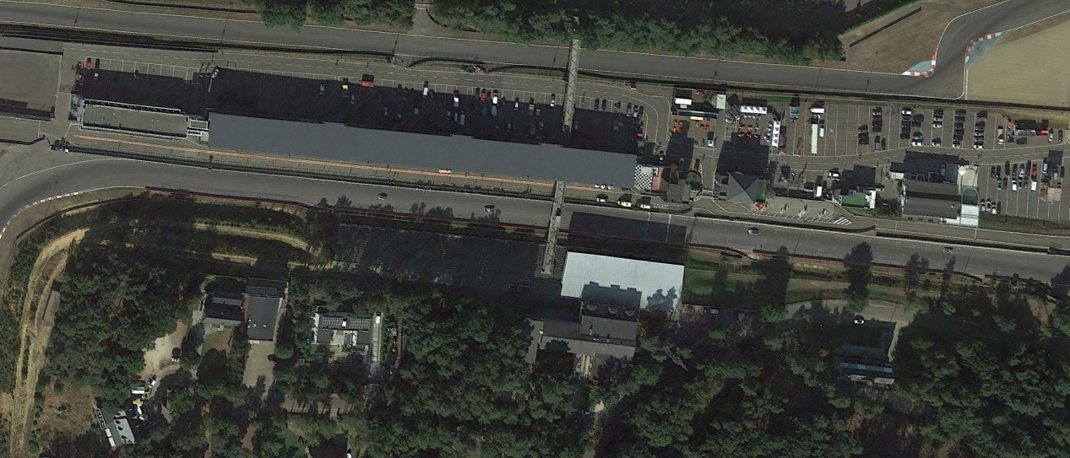
PIT LANE
PIT EXIT line
PIT ENTRY line
411 m

Slide 36
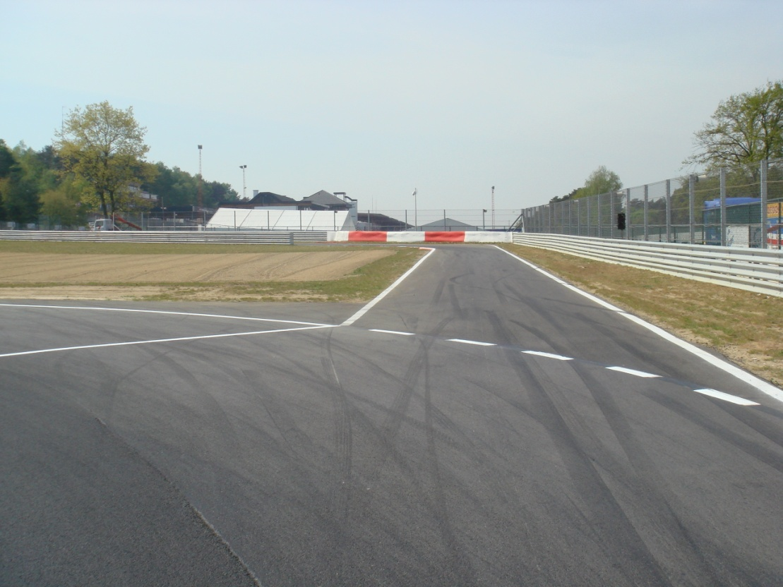
PIT ENTRY
SAFETY CAR LINE 1

Slide 37
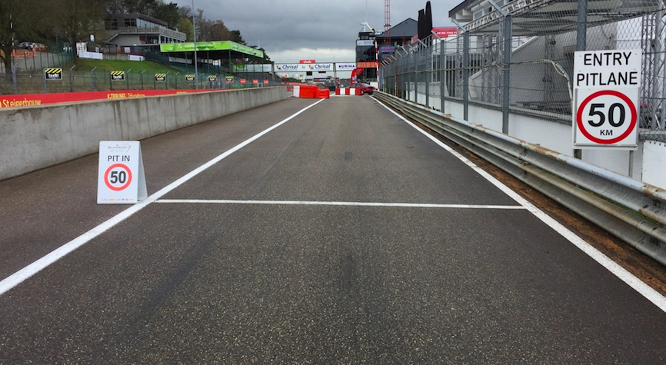
PIT ENTRY SPEED LIMIT LINE

Slide 38
STOP & GO – TIME PENALTY
In front of your pit garage

Slide 39
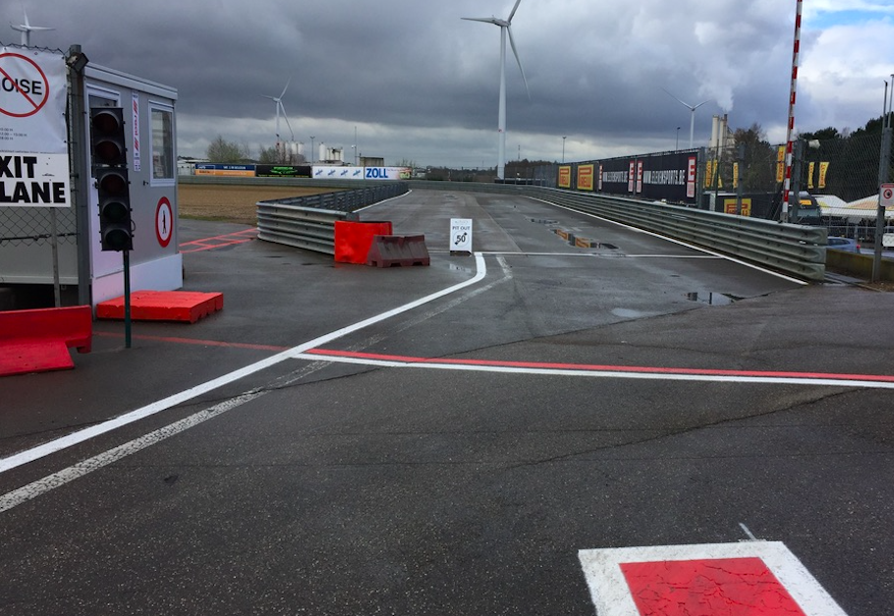
PIT EXIT SPEED LIMIT LINE

Slide 40
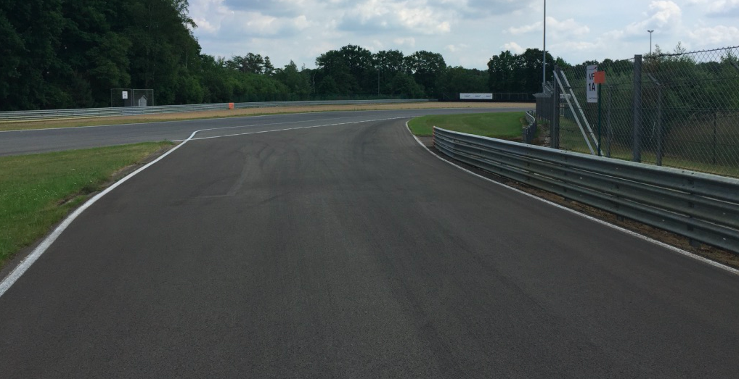

BLUE FLAG AT PIT EXIT

Slide 41
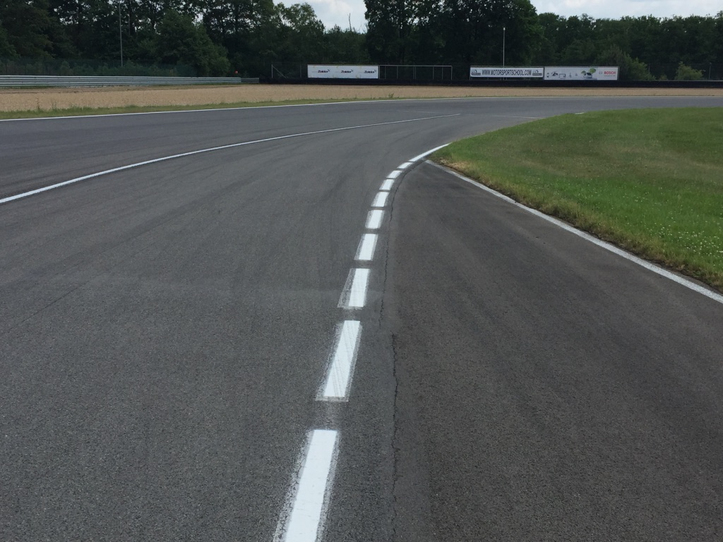
PIT EXIT LINE

Slide 42
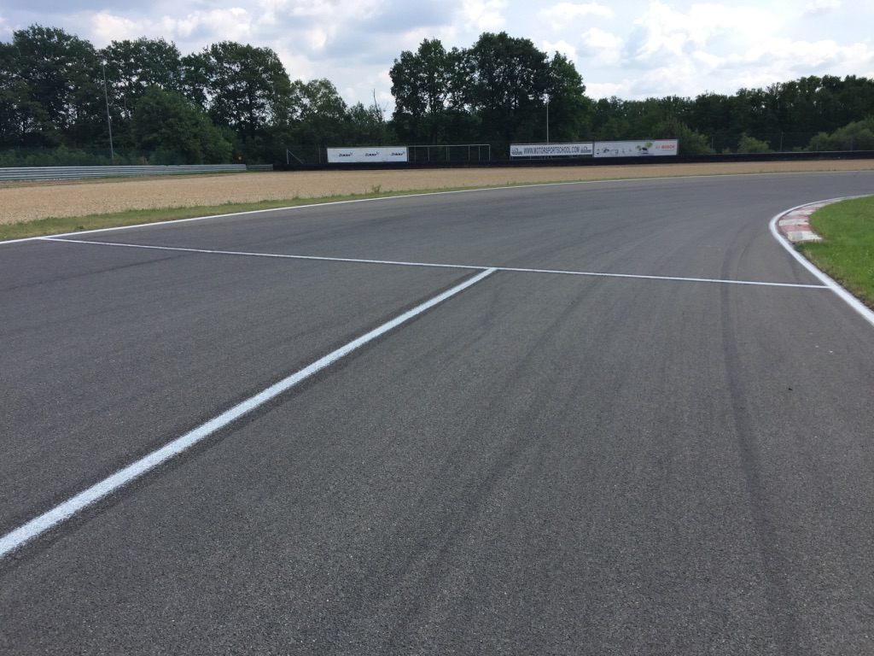
PIT EXIT LINE
SAFETY CAR LINE 2

Slide 43
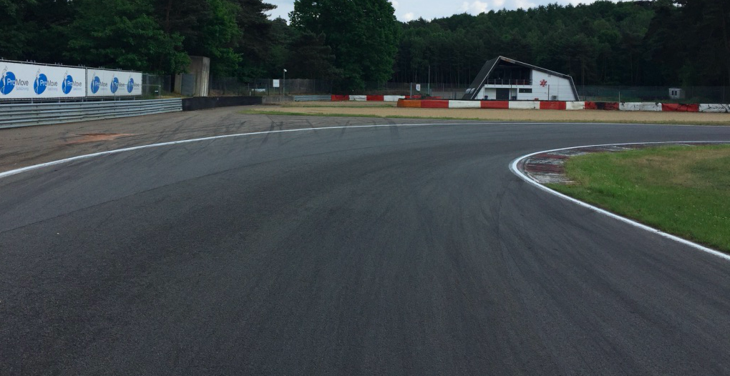
T12 ESCAPE ROAD

Slide 44
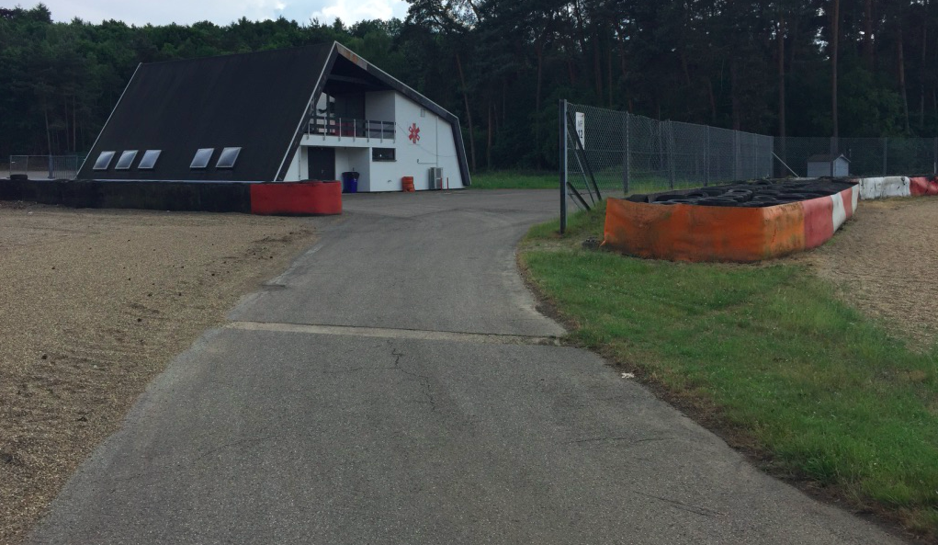
T12 ESCAPE ROAD

Slide 45
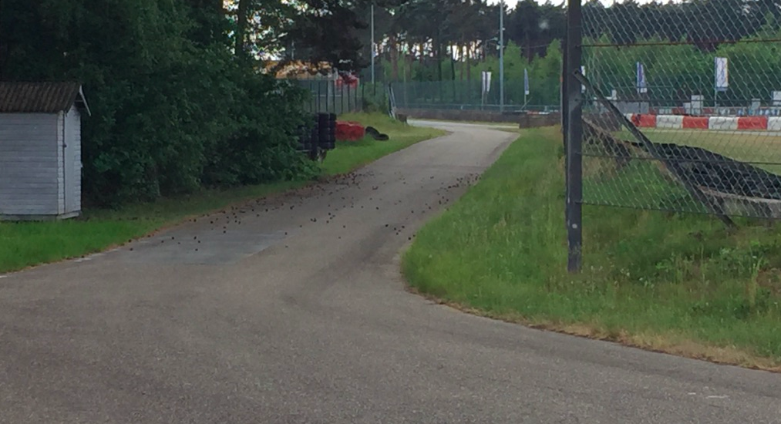
ESCAPE ROAD T12

Slide 46
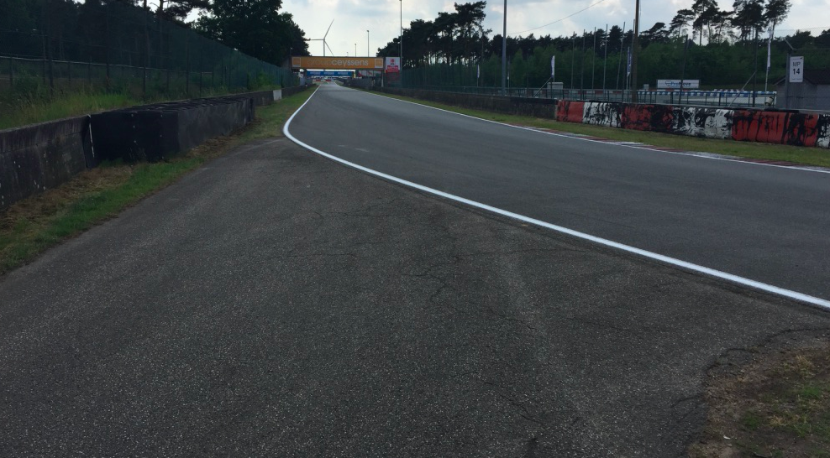
ESCAPE ROAD T12

Slide 47
Zolder (BELGIUM)
Circuit length: 4000 m
Start line offset: 0 m
Intermediate 1 at: 1376,4 m
Intermediate 2 at: 2864,6 m
Pit IN to Pit OUT: 411 m
T2
T3
NO TYRE WARMING UP
Start
Finish
T1
T16
T14
T4
T12
T15
T6
T5
Int 1
T13
Rolling start formation
T7
Int 2
T9
T8
T11
T10

Slide 48
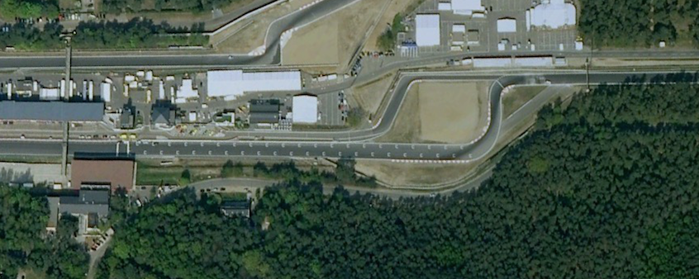
ROLLING START
Pole Posn Left
Hand Side

Slide 49
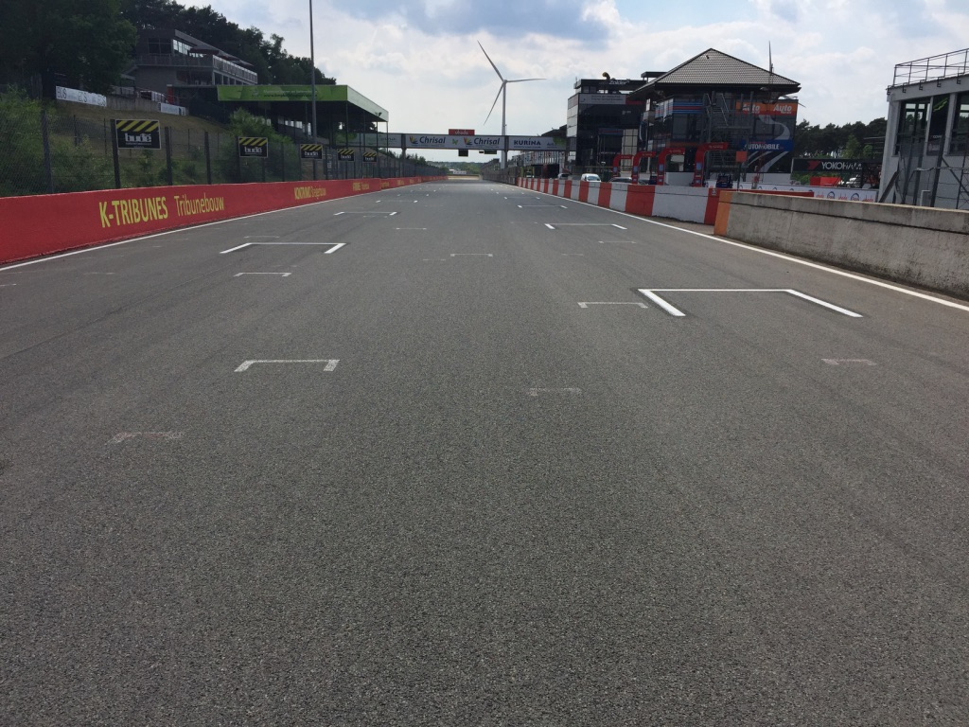
ROLLING START

Slide 50
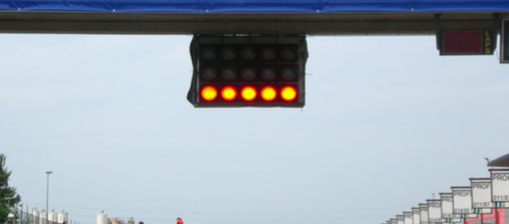
START

Slide 51

START

Slide 52
START
Red lights remains ON
Yellow flag @ all MP
Pole man - tempo

Slide 53
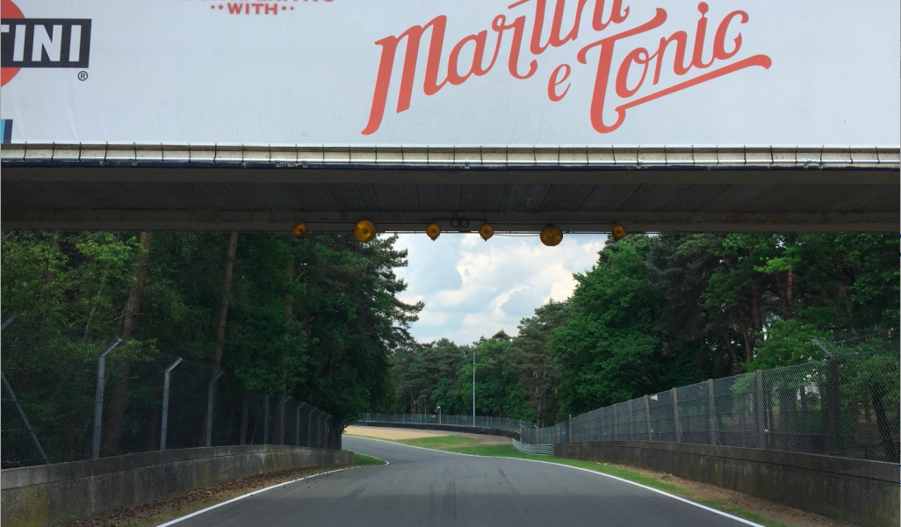
YELLOW FLAG Turn 7

Slide 54
YELLOW FLAG Turn 7

Slide 55
YELLOW FLAG Turn 7

Slide 56
YELLOW FLAG Turn 7

Slide 57
YELLOW FLAG Turn 7

Slide 58
YELLOW FLAG Turn 7

Slide 59
YELLOW FLAG Turn 7

Slide 60
YELLOW FLAG Turn 7

Slide 61
YELLOW FLAG Turn 7

Slide 62

FCY
SC
Speed 80 Km/Hr – NO Zig Zag
SC always preceded by FCY except during the 3 1st laps
SC get the leader during the FCY
Countdown
  At 10 sec boards & lights – No overtaking
  At 0 sec yellow flags & all cars at 80 Km/Hr
  Green flag on short notice - GREEN

Slide 63
Zolder (BELGIUM)
Circuit length: 4000 m
Start line offset: 0 m
Intermediate 1 at: 1376,4 m
Intermediate 2 at: 2864,6 m
Pit IN to Pit OUT: 411 m
T2
T3
Safety Car position Start lap and race
Start
T1
T16
Finish
T14
T4
T12
T15
T6
T5
Int 1
T13
SC lights off
T7
Int 2
T9
T8
T11
T10

Slide 64
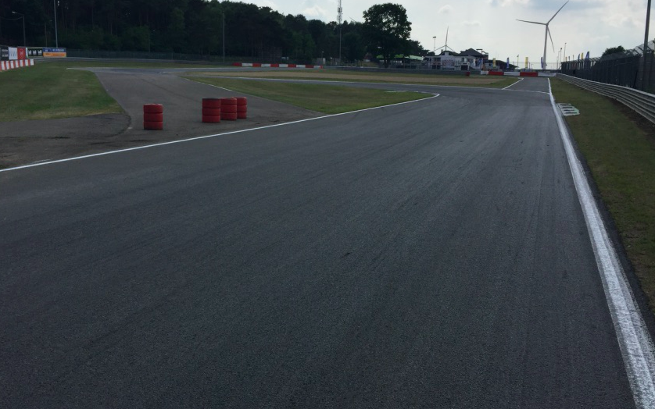
SAFETY CAR
SC POSITION

Slide 65
SC LIGHTS OFF - T12

Slide 66
PROCEDURE
Slow down to 80 Km/Hr - NO overtaking
Free practices: - The clock will NOT stop
- enter the pit lane – to your pit
During Qualifying: - The clock stops
- enter the pit lane – to your pit
During the race: - The clock will stop
- Cars to line up in front of the red line
- Order: as when the red flag was declared
- Teams and officials ONLY
– Parc-Fermé conditions – Restart behind SC
If you enter the pits after the red flag: restart one lap later

Slide 67
PROCEDURE
During the pit window:
- Cars back to the pit
– Parc-Fermé conditions
- pit stop permitted, when done PF
- Marshals will call the cars to line up in the order at the line of the last full lap before the opening of the pit window

Slide 68
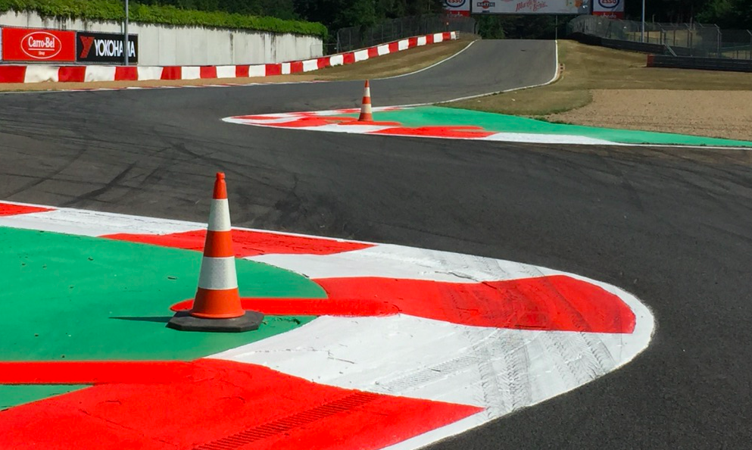
TRACK LIMITS
Keep in contact with the track
Not on the green

Slide 69
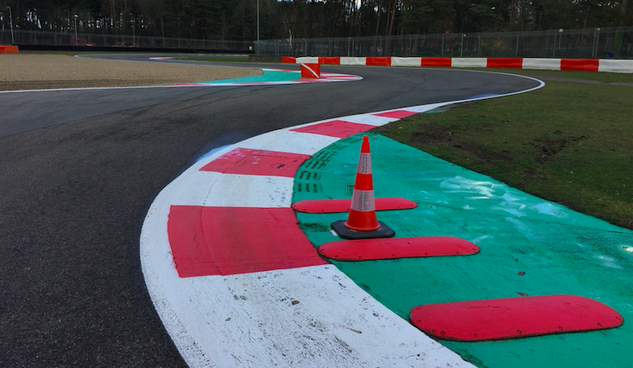
TRACK LIMITS

Slide 70
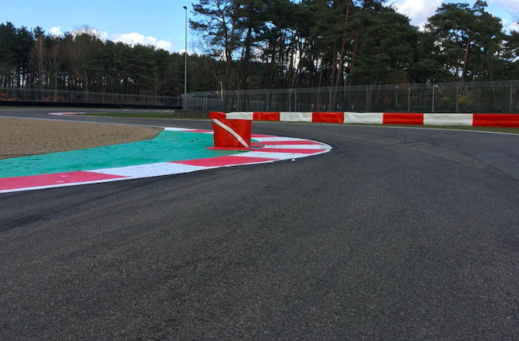
TRACK LIMITS
Keep in contact with the track
Not on the green

Slide 71
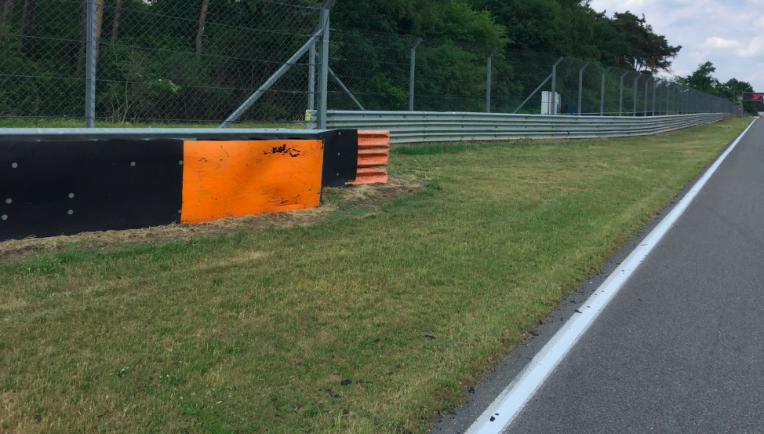
OPENING FOR CARS
Marked in orange

Slide 72


